Slide 1
Expedia Hotel price prediction
Team Dragonflies

Slide 2
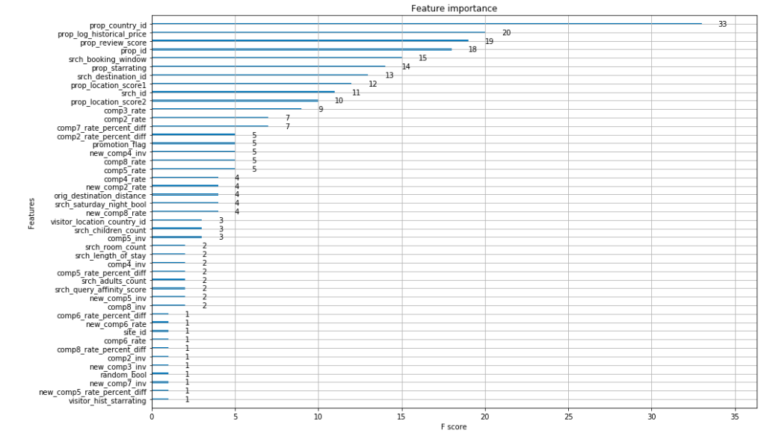
Non-linear approach
Since linear regression methods have not performing well, which underfit our dataset, so we tried some non-linear methods to fit the data.
Gradient Boosted Decision Trees (GBDT):
Implemented using sklean XGBoost
Get feature importance: prop_country_id, prop_historical_price, prop_review_score, prop_id, srch_booking_windows, etc. (ranked in descending order by importance)

Slide 3
Non-linear dimension reduction
Variables of training data:
categorical binary variables: 200
categorical non binary variables: 8
continuous variables: 28
Since most variables exist in our training dataset are categorical variables, so we tried implementing “autoencoder” to handle our categorical variables. It is a non-linear method to reduce dimensions.

Slide 4
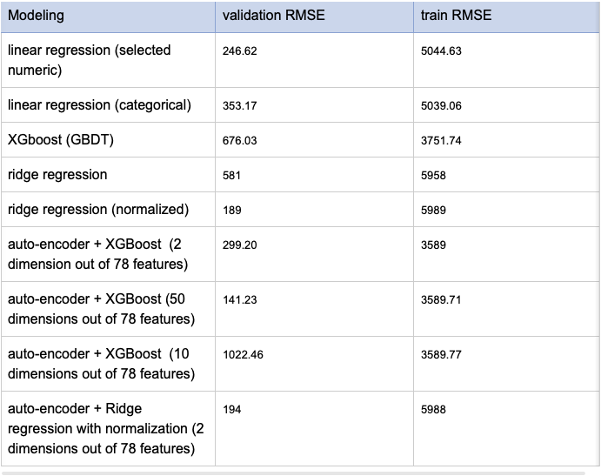
Modeling methods comparison
*Note: we sampled 5000 in temporal order from the entire training dataset
(3200 training examples, 800 validation examples, 1000 test examples)

Slide 5
Next step
There are two approaches in general in addressing the problem.
Feature engineering + regression modeling
Improve feature selection:
consider adding more features based on domain knowledge, e.g. variance of transaction amount in a day Need more exploration
Continue work on non-linear modeling
Hyper parameter tuning
Deep learning
Advantage: avoid complicated feature engineering
Modeling methods:
Seq2seq
Autoencoder (handling categorical variable) + LSTM(handling sequence variable)

Slide 6
Challenges
What do users care about?
Idea 1: predict hotel price per search_id per given timestamp (Current approach) → is this what users would need?
`date_time` as indicator for Recency
Idea 2: predict hotel price per region per time-interval, e.g. previous week predict next week → user would search for certain regions instead of the others ahead of departure
`date_time` used in sequence prediction
Hotel Price of region A in the previous week
“Black box”
Hotel Price of region A in the next week
Idea 3: predict hotel price per property per time-interval, e.g. previous week predict next week → user would search for certain hotels instead of the others
Hotel Price of property X in the previous week
“Black box”
Hotel Price of property X in the next week

Slide 7

THANKS!

Slide 8
Idea 4: predict hotel price per search_id per time-interval, e.g. previous week predict next week → in such case, can incorporate all search info from training dataset
Hotel Price per search_id in the previous week
“Black box”
Hotel Price per search_id in the next week
Use average or median price of per search_id to represent the price in one day
Possibly to add feature based on domain knowledge, (e.g. variance of price per search_id in one day)
LSTM
Seq2seq
output
input
Mon. [ <feature embedding> ]
Tue. [ <feature embedding> ]
Wed. …
Thu. …
…
Sun. ...
Mon. [ <feature embedding> ]
Tue. [ <feature embedding> ]
Wed. …
Thu. …
…
Sun. ...
Notes:
*Note: Currently working on to see if this assumption can be implemented.

